Slide 1
Unit 4: Atomic Hookups—Chemical Bonding
4.8
DATE:
TOPIC/ Objective: I will distinguish between polar & nonpolar compounds and bonds.
Essential question: How do we distinguish between polar & nonpolar compounds & bonds?
AGENDA
Do Now
Introduction
Mini-Lesson
Summary
Work Period
DO NOW:
Complete Do Now Slip.
You have 5 minutes.
Exit Slip

Slide 2
Unit 4: Atomic Hookups—Chemical Bonding
4.8
How do we distinguish between
polar & nonpolar compounds & bonds?
ANNOUNCEMENTS:

Slide 3
Unit 4: Atomic Hookups—Chemical Bonding
4.8
How do we distinguish between
polar & nonpolar compounds & bonds?
DO NOW:
Draw the Lewis Dot Structure of C₂H₂

Slide 4
Unit 4: Atomic Hookups—Chemical Bonding
4.8
How do we distinguish between
polar & nonpolar compounds & bonds?
QUESTION
How are the Lewis Dot structures of HF and F₂ different from each other?
NOTES
HINT: Draw them first

Slide 5
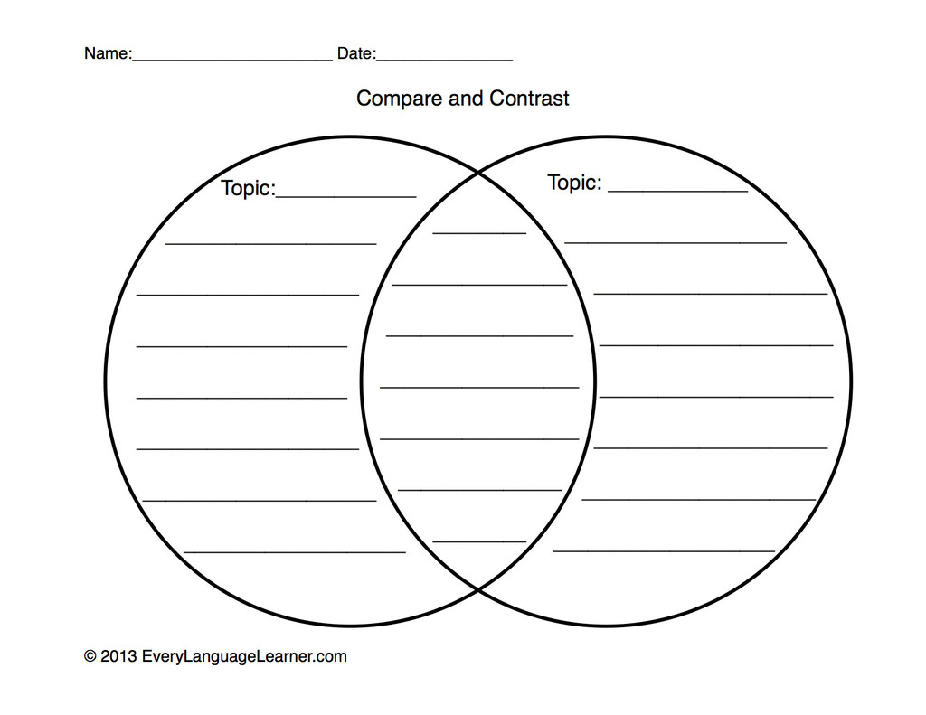
Unit 4: Atomic Hookups—Chemical Bonding
4.8
How do we distinguish between
polar & nonpolar compounds & bonds?
QUESTION
What does polarity mean?
Polar vs. Nonpolar covalent bonds
NOTES
Polarity means separation of charges.

Slide 6
Unit 4: Atomic Hookups—Chemical Bonding
4.8
How do we distinguish between
polar & nonpolar compounds & bonds?
Nonpolar covalent
bond
Polar covalent
bond
Both
Electrons are attracted equally to both atoms in bond
Electrons are attracted to one atom more than another
Covalent bonds
(between two nonmetals)
Examples: Diatomic molecules (F₂, H₂, O₂₎
Examples: HCl, HF, CCl
Electronegativity difference: 0.5 or less
Electronegativity difference: more than 0.5

Slide 7
Unit 4: Atomic Hookups—Chemical Bonding
4.8
How do we distinguish between
polar & nonpolar compounds & bonds?
A Visual

Slide 8
Unit 4: Atomic Hookups—Chemical Bonding
4.8
How do we distinguish between
polar & nonpolar compounds & bonds?
SAMPLE QUESTION #1
. Raise your finger corresponding to answer choice:
Which of the following compounds contains a nonpolar covalent bond?
A) CCl₄
B) NaBr
C) HF
D) Br₂
You must write down your answer
AND your partner’s answer & reasoning!

Slide 9
Unit 4: Atomic Hookups—Chemical Bonding
4.8
How do we distinguish between
polar & nonpolar compounds & bonds?
SAMPLE QUESTION #2
. Raise your finger corresponding to answer choice:
Which of the following does not a nonpolar covalent bond?
A) N₂
B) H₂O
C) O₂
D) CaI₂
You must write down your answer
AND your partner’s answer & reasoning!

Slide 10
Unit 4: Atomic Hookups—Chemical Bonding
4.8
How do we distinguish between
polar & nonpolar compounds & bonds?
QUESTION
What is a dipole moment?
NOTES
It is when a molecular substance (covalent compound) has a partially positive end and partially negative end.
***IMPORTANT: Only occurs in polar covalent bonds
Symbol used to represent it:

Slide 11
Unit 4: Atomic Hookups—Chemical Bonding
4.8
How do we distinguish between
polar & nonpolar compounds & bonds?
NOTES
Lower
Higher

Slide 12
Unit 4: Atomic Hookups—Chemical Bonding
4.8
How do we distinguish between
polar & nonpolar compounds & bonds?
QUESTION
To draw a dipole moment:
NOTES
Examples:
HF
HCl
CO

Slide 13
Unit 4: Atomic Hookups—Chemical Bonding
4.8
How do we distinguish between
polar & nonpolar compounds & bonds?
YOU TRY

Slide 14
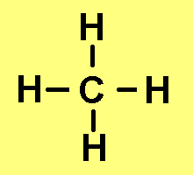
Unit 4: Atomic Hookups—Chemical Bonding
4.8
How do we distinguish between
polar & nonpolar compounds & bonds?
Nonpolar covalent
compound
Polar covalent
compound
Both
Compounds where electrons are spread out evenly
Compounds where electrons are not spread out evenly
Covalent compounds
(between two nonmetals)
Example:
Example:
Shape: Symmetrical
Shape:
Asymmetrical

Slide 15
Unit 4: Atomic Hookups—Chemical Bonding
4.8
How do we distinguish between
polar & nonpolar compounds & bonds?
YOU TRY

Slide 16
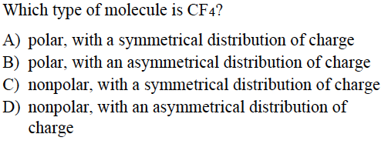
Unit 4: Atomic Hookups—Chemical Bonding
4.8
How do we distinguish between
polar & nonpolar compounds & bonds?
SAMPLE QUESTION #1
. Raise your finger corresponding to answer choice:

Slide 17
Unit 4: Atomic Hookups—Chemical Bonding
4.8
How do we distinguish between
polar & nonpolar compounds & bonds?
SAMPLE QUESTION #4
. Raise your finger corresponding to answer choice:

Slide 18
Unit 4: Atomic Hookups—Chemical Bonding
4.8
How do we distinguish between
polar & nonpolar compounds & bonds?
QUESTION
Two questions I have are…
NOTES
1.
2.
SUMMARY:

Slide 19
Unit 4: Atomic Hookups—Chemical Bonding
4.8
How do we distinguish between
polar & nonpolar compounds & bonds?
HOMEWORK:
Finish classwork of 4.8
Write a summary of today’s lesson
Create two questions
Highlight important information from the lesson

Slide 20
Unit 4: Atomic Hookups—Chemical Bonding
4.8
How do we distinguish between
polar & nonpolar compounds & bonds?
EXIT SLIP
Make sure you get your trackers checked!

