Slide 1


Unit 4: Atomic Hookups—Chemical Bonding
4.1
DATE:
TOPIC/ Objective: I will distinguish between types of ions and atoms
Essential question: How can we distinguish between ions and atoms?
AGENDA
Do Now
Introduction
Mini-Lesson
Summary
Work Period
DO NOW:
Complete Do Now Slip.
You have 5 minutes.
Exit Slip

Slide 2
Unit 4: Atomic Hookups—Chemical Bonding
4.1
How can we distinguish
between ions and atoms?
DO NOW
Raise your finger corresponding to answer choice:
An atom of an element contains 20 protons, 20 neutrons, and 20 electrons. The element is
an alkali metal
a noble gas
an alkaline earth metal
a halogen

Slide 3
Unit 4: Atomic Hookups—Chemical Bonding
4.1
How can we distinguish
between ions and atoms?
QUESTION
How are potassium atoms different from potassium ions?
NOTES
The atom is different from the ion because
STOP AND JOT/TURN AND TALK:
Write down your answer for 1 minute.
Then turn and talk to your group for 45 seconds to share answers

Slide 4
Unit 4: Atomic Hookups—Chemical Bonding
4.1
How can we distinguish
between ions and atoms?
QUESTION
What is an ion?
What is a neutral atom?
NOTES
An ion has extra electrons or less electrons
Example: Na⁺, O⁻²
A neutral atom is an atom where number of electrons = number of protons (atomic #)
Example: Na, Mg

Slide 5
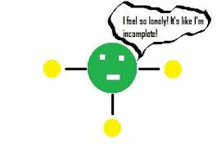
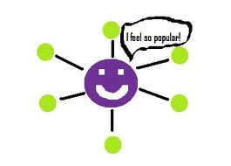
Unit 4: Atomic Hookups—Chemical Bonding
4.1
How can we distinguish
between ions and atoms?
QUESTION
What is the octet rule?
Why are noble gases the most stable atoms?
NOTES
Every elements wants valence electrons (a full valence electron shell). (THINK: “Get noble or die tryin” or “I want to be a noble gas so friggin’ bad”)
Think Ink-Pair Share
I think….
My partner thinks…

Slide 6
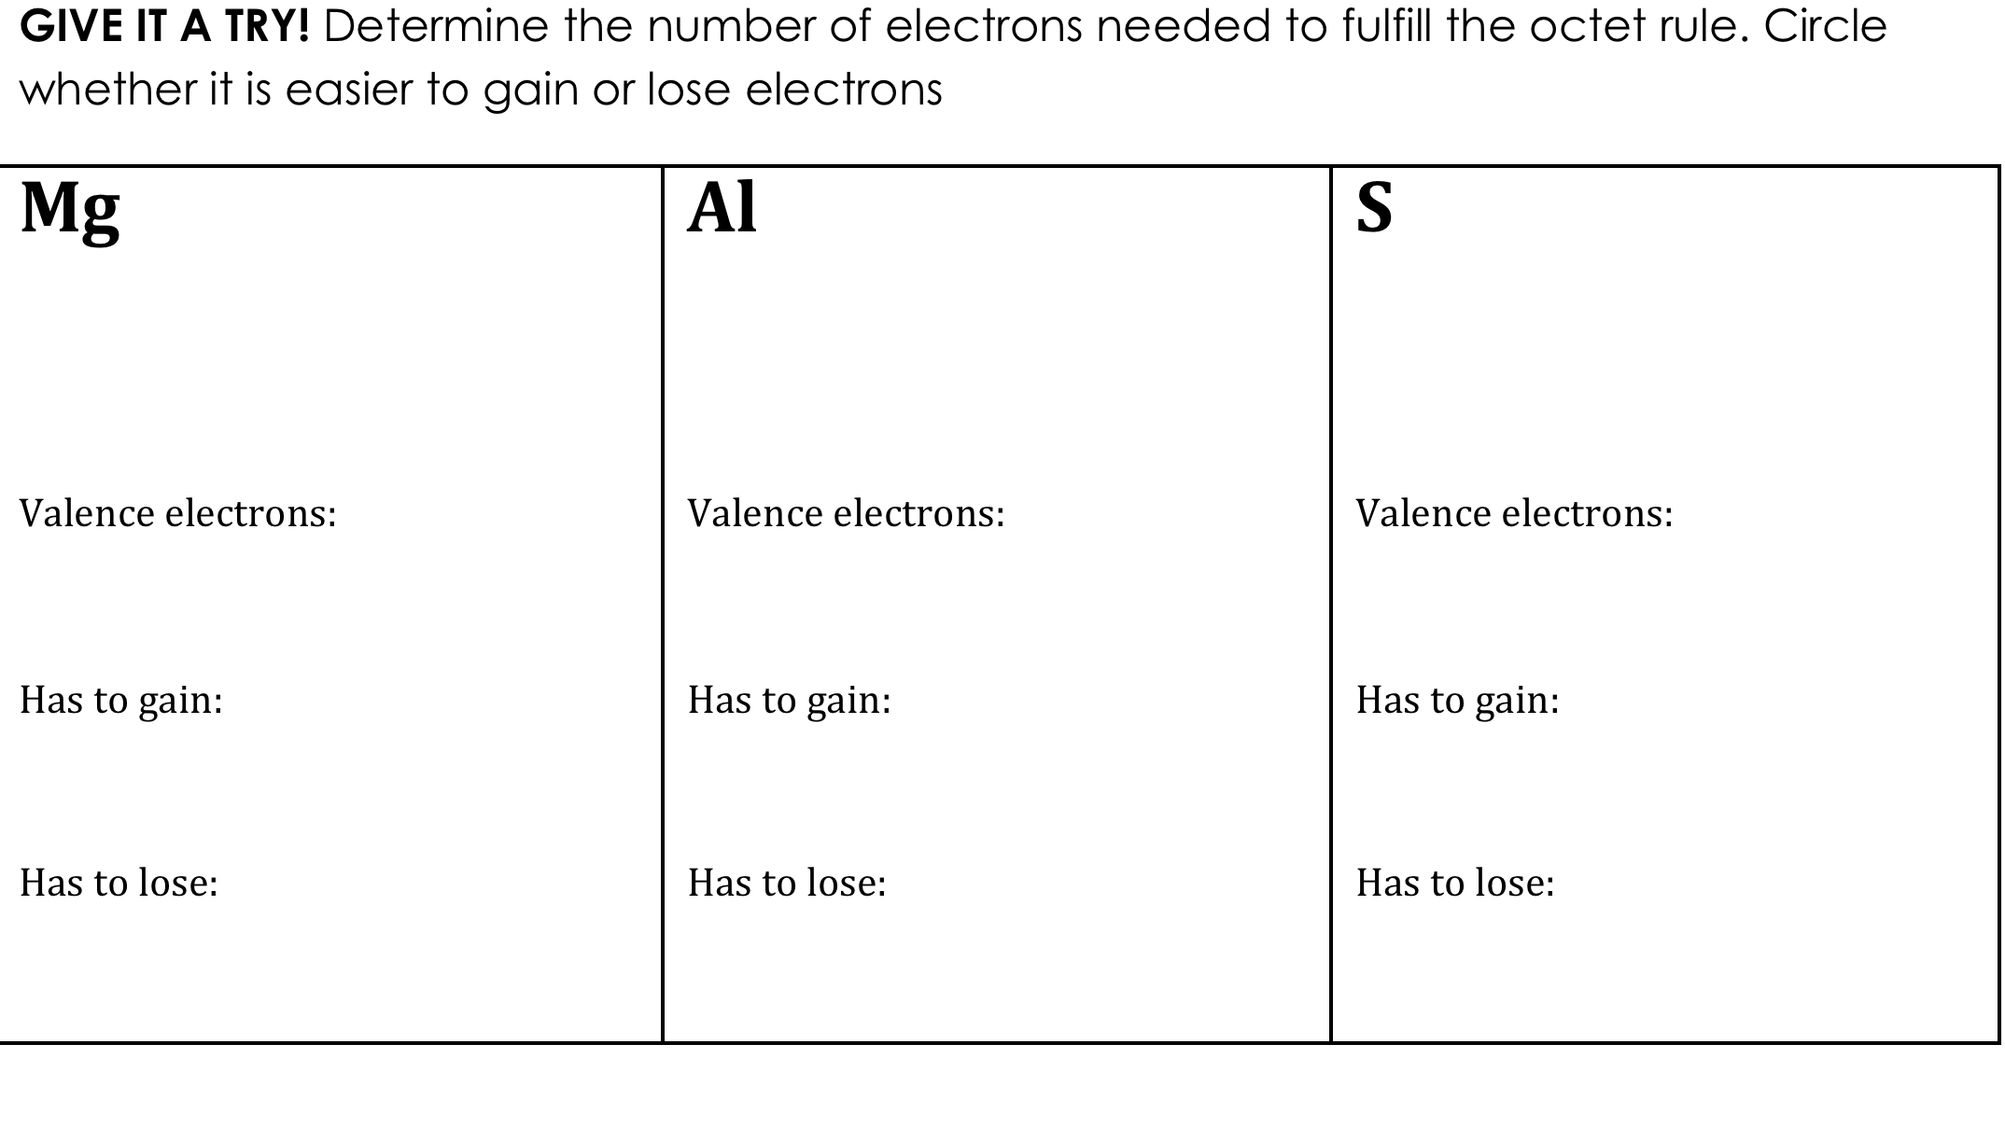
Unit 4: Atomic Hookups—Chemical Bonding
4.1
How can we distinguish
between ions and atoms?

Slide 7
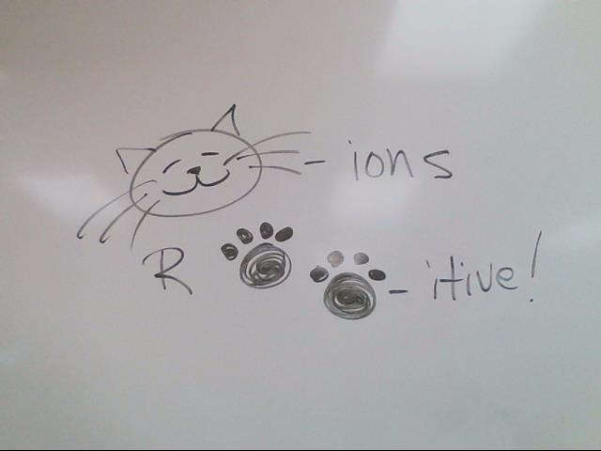
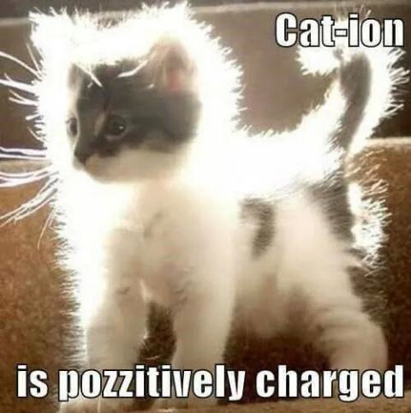
Unit 4: Atomic Hookups—Chemical Bonding
4.1
How can we distinguish
between ions and atoms?
QUESTION
What is a cation?
NOTES
Definition: a positive ion
Charge of ion: positive
Gain or lose electrons?:
Smaller or larger radius?
Examples:
Types of elements
Way to remember:

Slide 8
Unit 4: Atomic Hookups—Chemical Bonding
4.1
How can we distinguish
between ions and atoms?
QUESTION
What is an anion?
NOTES
Definition: a negative ion
Charge of ion: negative
Gain or lose electrons?
Smaller or larger radius?
Examples:
Types of elements
Way to remember:

Slide 9



Unit 4: Atomic Hookups—Chemical Bonding
4.1
How can we distinguish
between ions and atoms?
How to use reference table?

Slide 10
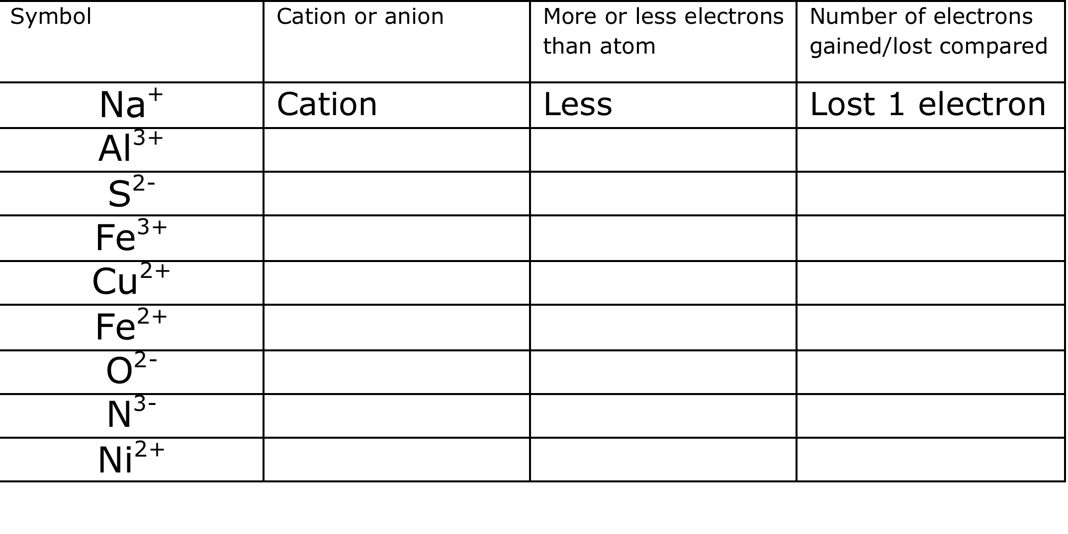
Unit 4: Atomic Hookups—Chemical Bonding
4.1
How can we distinguish
between ions and atoms?
YOU TRY:

Slide 11
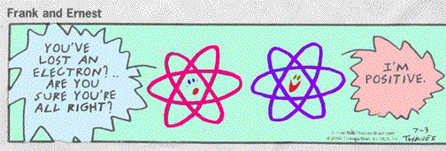
Unit 4: Atomic Hookups—Chemical Bonding
4.1
How can we distinguish
between ions and atoms?
FREE-WRITE
Title: Ions Freewrite (pg _____)
Explain what the cartoon means.

Slide 12
Unit 4: Atomic Hookups—Chemical Bonding
4.1
How can we distinguish
between ions and atoms?
SAMPLE QUESTION #1:
Raise your finger corresponding to answer choice:
What is the total number of valence electrons in an ion of boron in the ground state?
8
2
5
3
Which particle has the same electron configuration as a calcium ion?
A) fluoride ion B) sodium ion C) potassium atom D) argon atom
What is the net charge of an ion that has 13 protons, 12 neutrons, and 10 electrons?
A) +1 B) +3 C) -1 D) -3
Which electron configuration is correct for a sodium ion?
2–7 B) 2–8 C) 2–8–1 D) 2–8–2
Compared to a calcium atom, the calcium ion Ca²⁺ has
more protons B) fewer protons C) more electrons D) fewer electrons

Slide 13
Unit 4: Atomic Hookups—Chemical Bonding
4.1
How can we distinguish
between ions and atoms?
SAMPLE QUESTION #2:
Raise your finger corresponding to answer choice:
Which particle has the same electron configuration as a calcium ion?
fluoride ion
sodium ion
potassium atom
argon atom

Slide 14
Unit 4: Atomic Hookups—Chemical Bonding
4.1
How can we distinguish
between ions and atoms?
SAMPLE QUESTION #3:
Raise your finger corresponding to answer choice:
What is the net charge of an ion that has 13 protons, 12 neutrons, and 10 electrons?
+1
+3
-1
-3

Slide 15
Unit 4: Atomic Hookups—Chemical Bonding
4.1
How can we distinguish
between ions and atoms?
SAMPLE QUESTION #4:
Raise your finger corresponding to answer choice:
Which electron configuration is correct for a sodium ion?
2–7
2–8
2–8–1
2–8–2

Slide 16
Unit 4: Atomic Hookups—Chemical Bonding
4.1
How can we distinguish
between ions and atoms?
SAMPLE QUESTION #4:
Raise your finger corresponding to answer choice:
Compared to a calcium atom, the calcium ion Ca²⁺ has
more protons
fewer protons
more electrons
fewer electrons

Slide 17
Unit 4: Atomic Hookups—Chemical Bonding
4.1
How can we distinguish
between ions and atoms?
QUESTION
Two questions I have are…
NOTES
1.
2.
SUMMARY:

Slide 18
Unit 4: Atomic Hookups—Chemical Bonding
4.1
How can we distinguish
between ions and atoms?
HOMEWORK:
Finish classwork of 4.1
Write a summary of today’s lesson
Create two questions
Highlight important information from the lesson

Slide 19
Unit 4: Atomic Hookups—Chemical Bonding
4.1
How can we distinguish
between ions and atoms?
EXIT SLIP
Make sure you get your trackers checked!

