Slide 1
Unit 2: A World of Particles: An Atom & Its Components
2.8
DATE:
TOPIC/ Objective:
I will explain wave-particle duality of an electron.
Essential question:
How can an electron act as both a particle and a wave?
AGENDA
Do Now
Introduction
Mini-Lesson
Summary
Work Period
DO NOW:
Complete Do Now sheet. You have 5 minutes.
Exit Slip

Slide 2
Unit 2: A World of Particles: An Atom & Its Components
2.8
How can an electron act as
both a particle and a wave?
Announcements
Quiz #4 on 2.5-2.8 tomorrow
Packet #3 is due on Friday 12/11
Frayer Model is due on Friday 12/11
Unit #2 Exam is on Thursday 12/10

Slide 3
Unit 2: A World of Particles: An Atom & Its Components
2.8
How can an electron act as
both a particle and a wave?
QUESTION
THINK-INK-PAIR-SHARE: What do you think wave-particle duality means?
NOTES
I think it means…
My partner thinks it means…

Slide 4
Unit 2: A World of Particles: An Atom & Its Components
2.8
How can an electron act as
both a particle and a wave?
QUESTION
Who discovered wave-particle duality?
NOTES

Slide 5
Unit 2: A World of Particles: An Atom & Its Components
2.8
How can an electron act as
both a particle and a wave?
QUESTION
Create a question based off the information given…
NOTES

Slide 6
Unit 2: A World of Particles: An Atom & Its Components
2.8
How can an electron act as
both a particle and a wave?
QUESTION
Create a question based off the information given…
NOTES

Slide 7
Unit 2: A World of Particles: An Atom & Its Components
2.8
How can an electron act as
both a particle and a wave?
QUESTION
What do you think is the relationship between wavelength and frequency?
NOTES

Slide 8
Unit 2: A World of Particles: An Atom & Its Components
2.8
How can an electron act as
both a particle and a wave?
QUESTION
What do you think is the relationship between wavelength and frequency?
NOTES

Slide 9
Unit 2: A World of Particles: An Atom & Its Components
2.8
How can an electron act as
both a particle and a wave?
QUESTION
IMPORTANT:
NOTES
When an atom enters an excited state, the number of electrons STAYS THE SAME but the location of the electrons CHANGES.

Slide 10
Unit 2: A World of Particles: An Atom & Its Components
2.8
How can an electron act as
both a particle and a wave?
QUESTION
One question I still have is…
NOTES
1.
SUMMARY:

Slide 11
Unit 2: A World of Particles: An Atom & Its Components
2.8
How can an electron act as
both a particle and a wave?
Practice Question:
What are the frequency and the energy of blue light that has a wavelength of 400 nm? (Planck’s constant = 6.63 x 10⁻³⁴ Js)

Slide 12
Unit 2: A World of Particles: An Atom & Its Components
2.8
How can an electron act as
both a particle and a wave?
YOU TRY:
What are the wavelength and the energy of light that has a frequency of 1.50 x 10¹⁵ s⁻¹?

Slide 13
Unit 2: A World of Particles: An Atom & Its Components
2.8
How can an electron act as
both a particle and a wave?
Practice Question
Annotate question. Raise your finger with correct answer.
Let’s go over Question #8 & 25

Slide 14
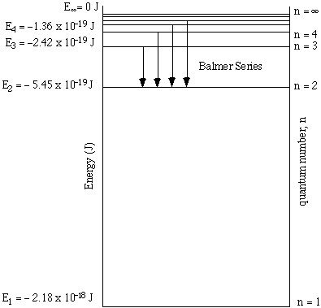
Unit 2: A World of Particles: An Atom & Its Components
2.8
How can an electron act as
both a particle and a wave?
Practice Question: Determine the energy and wavelength of light associated with an electron moving from the second to the fourth energy level in a hydrogen atom.

Slide 15
Unit 2: A World of Particles: An Atom & Its Components
2.8
How can an electron act as
both a particle and a wave?
Practice Question: Determine the energy and wavelength of light associated with an electron moving from the first to the third energy level in a hydrogen atom.

Slide 16
Unit 2: A World of Particles: An Atom & Its Components
2.8
How can an electron act as
both a particle and a wave?
Practice Question
Annotate question. Raise your finger with correct answer.
Let’s go over Question #15

Slide 17
Unit 2: A World of Particles: An Atom & Its Components
2.8
How can an electron act as
both a particle and a wave?
HOMEWORK:
Finish classwork of 2.8
Write a summary of today’s lesson
Create one question
Highlight important information from the lesson

Slide 18
Unit 2: A World of Particles: An Atom & Its Components
2.8
How can an electron act as
both a particle and a wave?
EXIT SLIP
Make sure you get your trackers checked!

