Slide 1
Unit 2: A World of Particles: An Atom & Its Components
2.6
DATE:
TOPIC/ Objective:
I will be able to draw the Lewis Dot structures of elements.
Essential question:
How can I represent the valence electrons of elements?
AGENDA
Do Now
Introduction
Mini-Lesson
Summary
Work Period
DO NOW:
Complete Do Now sheet. You have 5 minutes.
Exit Slip

Slide 2
Unit 2: A World of Particles: An Atom & Its Components
2.6
How can I represent the
valence electrons of elements?
Do Now:

Slide 3
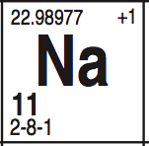
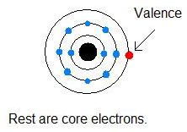
Unit 2: A World of Particles: An Atom & Its Components
2.6
How can I represent the
valence electrons of elements?
QUESTION
What are valence electrons?
NOTES
Outermost electrons of an atom

Slide 4
Unit 2: A World of Particles: An Atom & Its Components
2.6
How can I represent the
valence electrons of elements?
Try it!
Directions: Find the electron configuration for the following elements. Circle the valence electrons.
1. Magnesium: ______________
2. Potassium: _______________
3. Xenon: ________________
4. Calcium: ______________

Slide 5
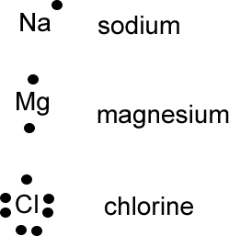
Unit 2: A World of Particles: An Atom & Its Components
2.6
How can I represent the
valence electrons of elements?
QUESTION
What is a Lewis Dot Structure?
NOTES
diagram to represent how the outermost electrons are arranged around elements and compounds
Examples

Slide 6
Unit 2: A World of Particles: An Atom & Its Components
2.6
How can I represent the
valence electrons of elements?
QUESTION
Steps of Lewis Dot Structure
NOTES
Write symbol of element
Find out # of valence electrons
Draw a dot representing each valence electron. (NOTE: Draw a dot on each side of the valence electron first before pairing
NOTES:
A. Cannot have no more than 2 on any side of symbol
B. No more than 8 dots in total
Example: 1) Be 2) F

Slide 7
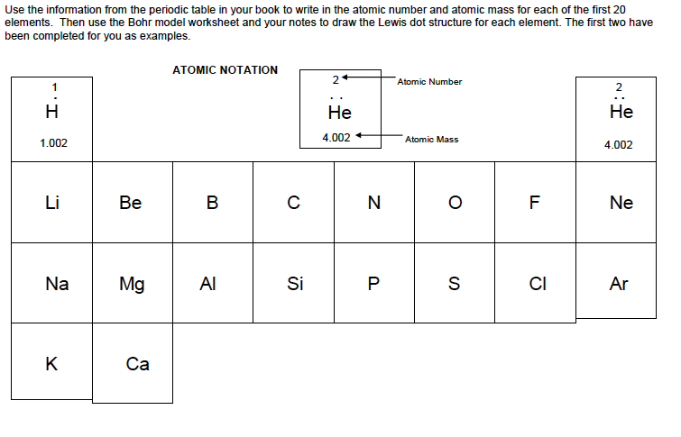
Unit 2: A World of Particles: An Atom & Its Components
2.6
How can I represent the
valence electrons of elements?
PRACTICE QUESTIONS

Slide 8
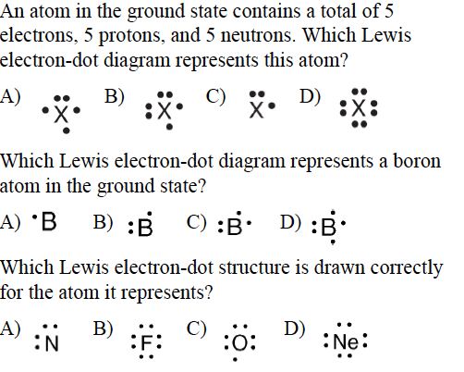
Unit 2: A World of Particles: An Atom & Its Components
2.6
How can I represent the
valence electrons of elements?
PRACTICE QUESTIONS

Slide 9
Unit 2: A World of Particles: An Atom & Its Components
2.6
How can I represent the
valence electrons of elements?
QUESTION
One question I still have is…
NOTES
1.
SUMMARY:

Slide 10
Unit 2: A World of Particles: An Atom & Its Components
2.6
How can I represent the
valence electrons of elements?
HOMEWORK:
Finish classwork of 2.6
Write a summary of today’s lesson
Create one question
Highlight important information from the lesson

Slide 11
Unit 2: A World of Particles: An Atom & Its Components
2.6
How can I represent the
valence electrons of elements?
EXIT SLIP
Make sure you get your trackers checked!

